Slide 1
The Effect of Free Trials and Promotions on the Gym Membership Increase
Would there be a 15% increase on the proportion of gym membership renewal?
5300 Research Design - Group 4
Authors: Sterben Shi, Xuan Song, Yiqi Wang, Yisong Wang, Jack Zhang

Slide 2

Background
Executive Summary
Examine gym attendance factors and strategies for long-term commitment.
Address membership barriers and emphasize exercise's health benefits.
Identify strategies to boost retention rates and improve public health.
Statement of the Problem
Highlight gym attendance for physical and mental well-being in sedentary lifestyles.
Address gym membership retention challenges and benefits of trial memberships.
Explore strategies to convert trial members and enhance overall retention rates.
Importance of Study
Enhance membership retention and customer satisfaction for gyms and fitness centers.
Investigate the impact of membership renewal policies and trainer sessions on member loyalty.
Contribute to overall well-being and promote healthier, more active lifestyles in communities.

Slide 3

Research Questions and Hypotheses
Will a 14-month membership renewal increase the proportion of membership renewals within one month compared to a 12-month membership renewal offer at the same price.
Relative to 3 free sessions with professional trainers offered by the gym within one year, would 5 free sessions with professional trainers offered by the gym within one year increase the proportion of membership renewals?
Relative to no free sessions with professional trainers offered by the gym within one year, would 3 free sessions with professional trainers offered by the gym within one year increase the proportion of membership renewals?

Slide 4
The Experimental Method
Population of Interest:
All current members of a national brand gym, whose memberships are about to expire in the next three months.
Exclusion criteria: those whose memberships will not end within the next 3 months
The authors will implement the research in a national brand gym in two separate geographic locations per research question. The members in the same local gym will be placed in the same group.
Sample Selection:
The sampled facilities (gym local branches) for this study will be assigned into treatment and control groups.
Reduce the study’s possible population down to the selected population before randomly drawing the sample.
Randomly draw the participants from the selected population pool in their respective groups
Sample Size
we can assume 15% increases in proportions as the effect size. We will also assume the sample size in the treatment group and control group (200 in the treatment group and 220 in the control group).

Slide 5
Experimental Operations
Operational Procedures
Randomly assign six gym branches from six different cities into three treatment and three control groups
Email members with offers based on group study group
Measure membership renewal rates
Brief Schedule
Phase 1 (Weeks 1-2): Secure gym permissions and prepare experiment
Phase 2 (Weeks 3-4): Distribute promotional offers through email
Phase 3 (Weeks 5-6): Gather and evaluate data on membership renewals
Data Collection and security
Gather data on membership renewal decisions
Record renewal data as binary variables
Store data on secure server
Use unique identification numbers for participants
Encrypt sensitive files and regularly back up data
Research staff involved in the study will undergo training in data security and confidentiality

Slide 6
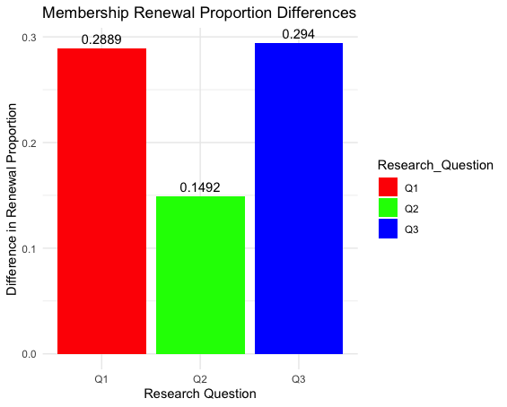
Simulations Studies and Statistical Analysis Plan
Two-Sided Proportion Test
Utilize a two-sided proportion test for all three research questions.
Simulations
Fix the random seed for repeatability.
Assume an effect size of 0.15 (15% increase).
Set the mean at 200 and the standard deviation at 20.
Establish a sample size of 200 for each group.
Assume the number of samples from all six groups follows N(200, 20^2), rounded to an integer.
Conduct a test to determine if the sample size of 200 is sufficient to support an effect size of 0.15, with a significance level of 0.05 and a power of approximately 0.46.
Test Conclusion
Confirm that the sample size of 200 is adequate to support the effect size.

Slide 7
Key Findings and Conclusion
Larger sample sizes increase the statistical power of a test, making it more likely to detect real differences or effects in the data.
For the first research question, a meaningful and significant effect can be detected when there is a higher proportion of renewal in the treatment group compared to the control group, otherwise, the null hypothesis cannot be rejected.
Similarly, for the second research question, a significant effect can be detected when there is a higher proportion of renewal in the treatment group compared to the control group, otherwise, the null hypothesis cannot be rejected.
For the third research question, a significant effect can be detected when there is a higher proportion of renewal in the treatment group compared to the control group, otherwise, the null hypothesis cannot be rejected.
A power of 0.45 may be useful in some contexts, but generally, a power of 0.8 or higher is desirable to have a reasonable chance of detecting a true effect.
Therefore, we recommend drawing as many samples as possible to increase the precision of the decision-making process.

